Slide 1

Big Data Storage
Hadoop Distributed file System(HDFS)

Slide 2

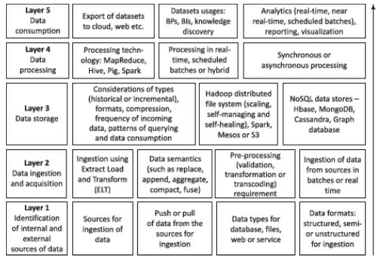
BIG DATA
Big Data Architecture
Notes:
1.3 billion * 10 kilobytes =0.013 petabytes
1.3 billion * 10 kilobytes =13 terabytes

Slide 3
HADOOP
What is Hadoop?
Hadoop is a distributed framework developed and maintained by Apache Software Foundation.
Open Source platform developed in Java.
HADOOP
HDFS
Map Reduce
File System to manage the storage of Data
Framework to process data across multiple servers

Slide 4
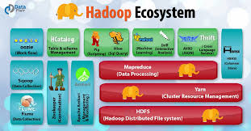
HADOOP
HADOOP ECO SYSTEM
Source: https://dataflair training.com
Notes:
1.3 billion * 10 kilobytes =0.013 petabytes
1.3 billion * 10 kilobytes =13 terabytes

Slide 5
Hadoop Distributed File System(HDFS)
Hadoop Storage

Slide 6

BIG DATA
Lecture overview - HDFS
Motivation for another File system
HDFS architecture
HDFS Operations
Blocks, Replication and Fault Tolerance
HDP platform

Slide 7



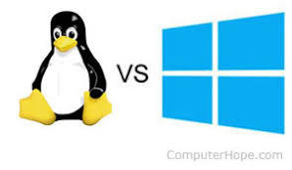
File System
Why another File System?
File System
Helps you to navigate to the data
Control how data is stored and retrieved
Metadata about the files and folders
Permissions and Security
Manage storage space efficiently
Have you used any of the file system before?
Your answer must be “Yes” because this is an integral component of any operating system
File systems that we are aware of
FAT,NTFS, HFS, ext3,ext4,XFS

Slide 8

Exabytes of Data
Current File Systems
8 EB pretty good to handle Big Data Sets
Any Guesses?
They why HDFS?
Get the Intuition using a real big data Problem

Slide 9

Case Study: How Google Search works?

Slide 10
Case Study: How Google Search works?

Slide 11
Motivations from Google Case Study
Hadoop Distributed File System
EXT 64
Is it DFS?
EXT 64
EXT 64
EXT 64
EXT 64

Slide 12
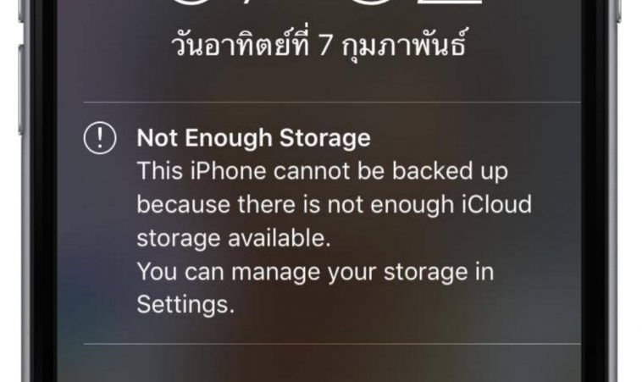
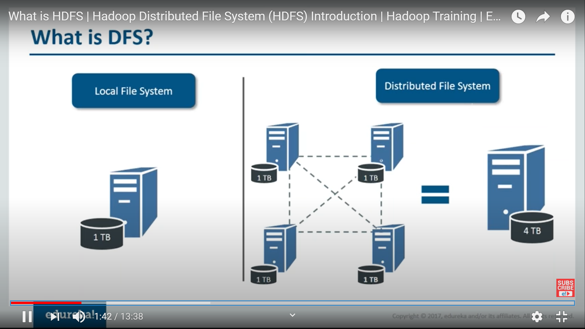
What is Distributed File System (DFS)?
Look in for options to store it in multiple locations
Source :http ://www.edureka.com

Slide 13
Capabilities of DFS
Manages files and folders across multiple computers
DFS can organize and store files as if they are residing in a local system
Not only storage controlled access to files over LAN and WAN

Slide 14
Hadoop Distributed File System
HDFS

Slide 15





WHY HDFS?
Let's understand
4.5 mts
1 TB
45 mts
1 TB

Slide 16
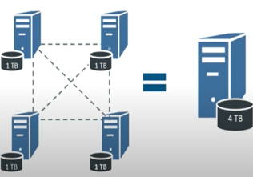
What is HDFS?
Hadoop Distributed File System
HDFS is a distributed file system that allows you to store large data across the cluster

Slide 17
What is HDFS?
Hadoop Distributed File System
Local File system
4
Replicate Blocks
3
2
Data loss
1
Top of Ext4

Slide 18

BIG DATA
HDFS – History
HDFS – Inspired by GFS
GFS – Google File System (2003)
Distributed File system on a cluster of machines
Developed by Doug Cutting and Mike Cafarella
Origin - Apache Nutch
Goal : web search engine on 1 Billion Pages
Open source

Slide 19
HDFS
Features of HDFS
HDFS is a filesystem designed for storing very large files with streaming data access patterns, running on clusters of commodity hardware
Very large-→files that are hundreds of megabytes, gigabytes, or terabytes in size
most efficient data processing pattern is a write-once, read-many-times pattern
Hadoop doesn’t require expensive, highly reliable hardware to run on. It’s designed to run on clusters of commodity hardware

Slide 20
HDFS
Is Hadoop a solution for all type of applications?
Low-latency data access
Lots of small files
Multiple writers, arbitrary file modifications

Slide 21
THANK YOU
“WORLD IS ONE BIG DATA PROBLEM”
“TORTURE THE DATA AND IT WILL CONFESS TO ANYTHING”

